Slide 1
Introduction to Artificial Intelligence and Machine Learning (AI/ML)
In Pursuit of Protein Structure and Design: A Nobel-Winning Journey in Two Parts
Cecilia Arighi, PhD
Instructor CIS and CBCB

Slide 2
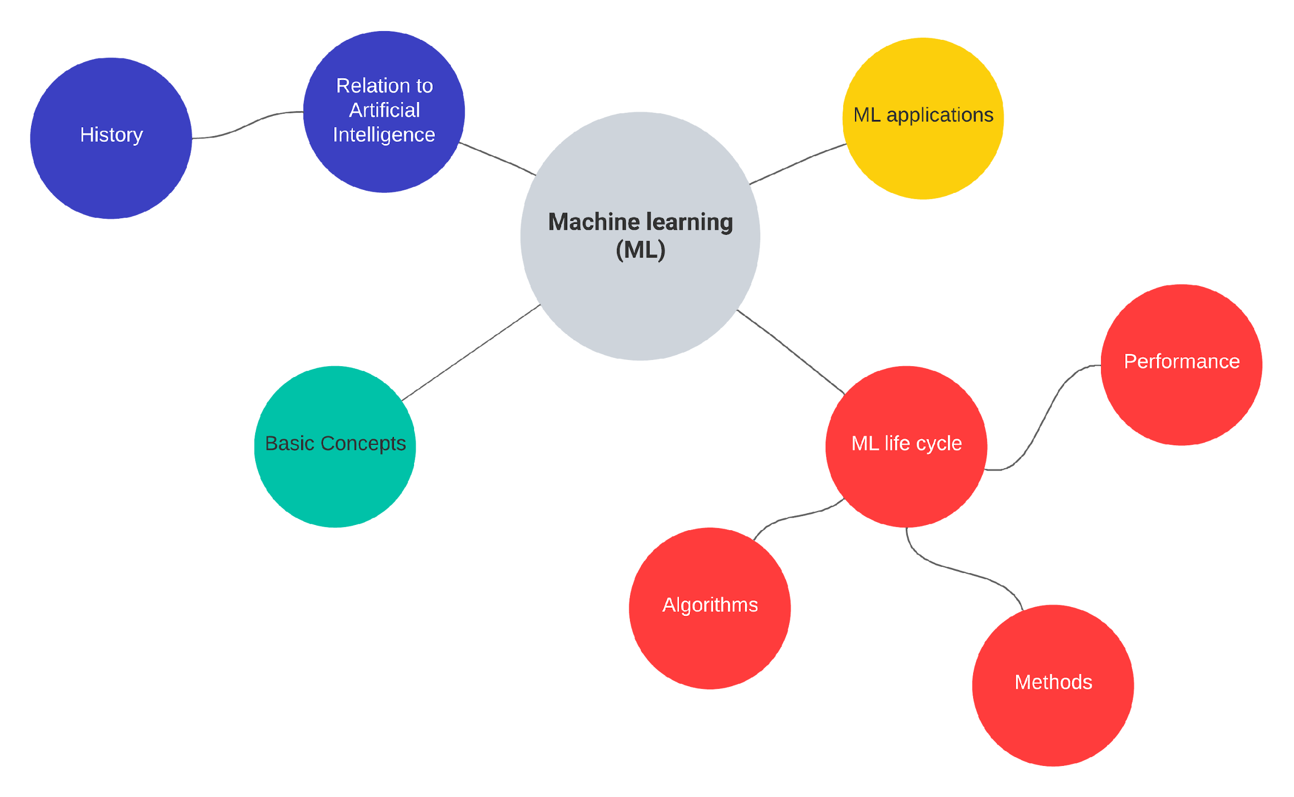

Slide 3
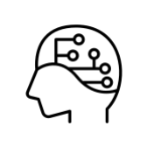

What is Artificial Intelligence (AI)?
“The science and engineering of making intelligent machines, especially intelligent computer programs”.
John McCarthy (one of the founders of AI discipline)
AI
Science of mimicking human behavior
Machine learning
Subset of AI that trains machine how to learn

Slide 4
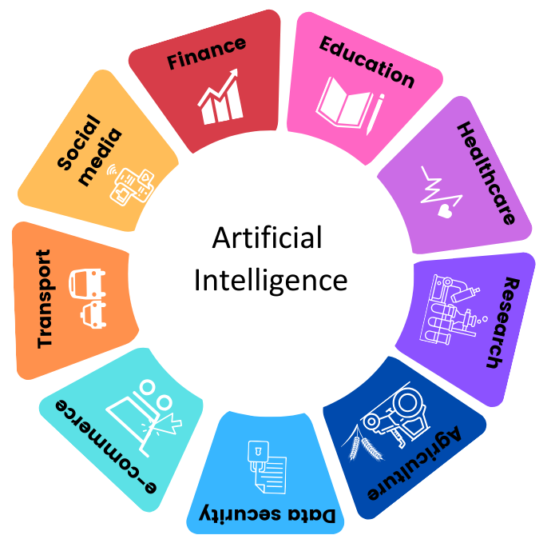
Artificial Intelligence (AI) is applied in a variety of sectors
Healthcare: AI can assist doctors to make better and faster diagnosis. Can provide insights and analysis of clinical data, improve patient monitoring, etc.
Biomedical Research: Can assist in prediction (e.g., protein structure), categorization (e.g., pathogenic vs. non-pathogenic variant), summarization of data, etc.

Slide 5
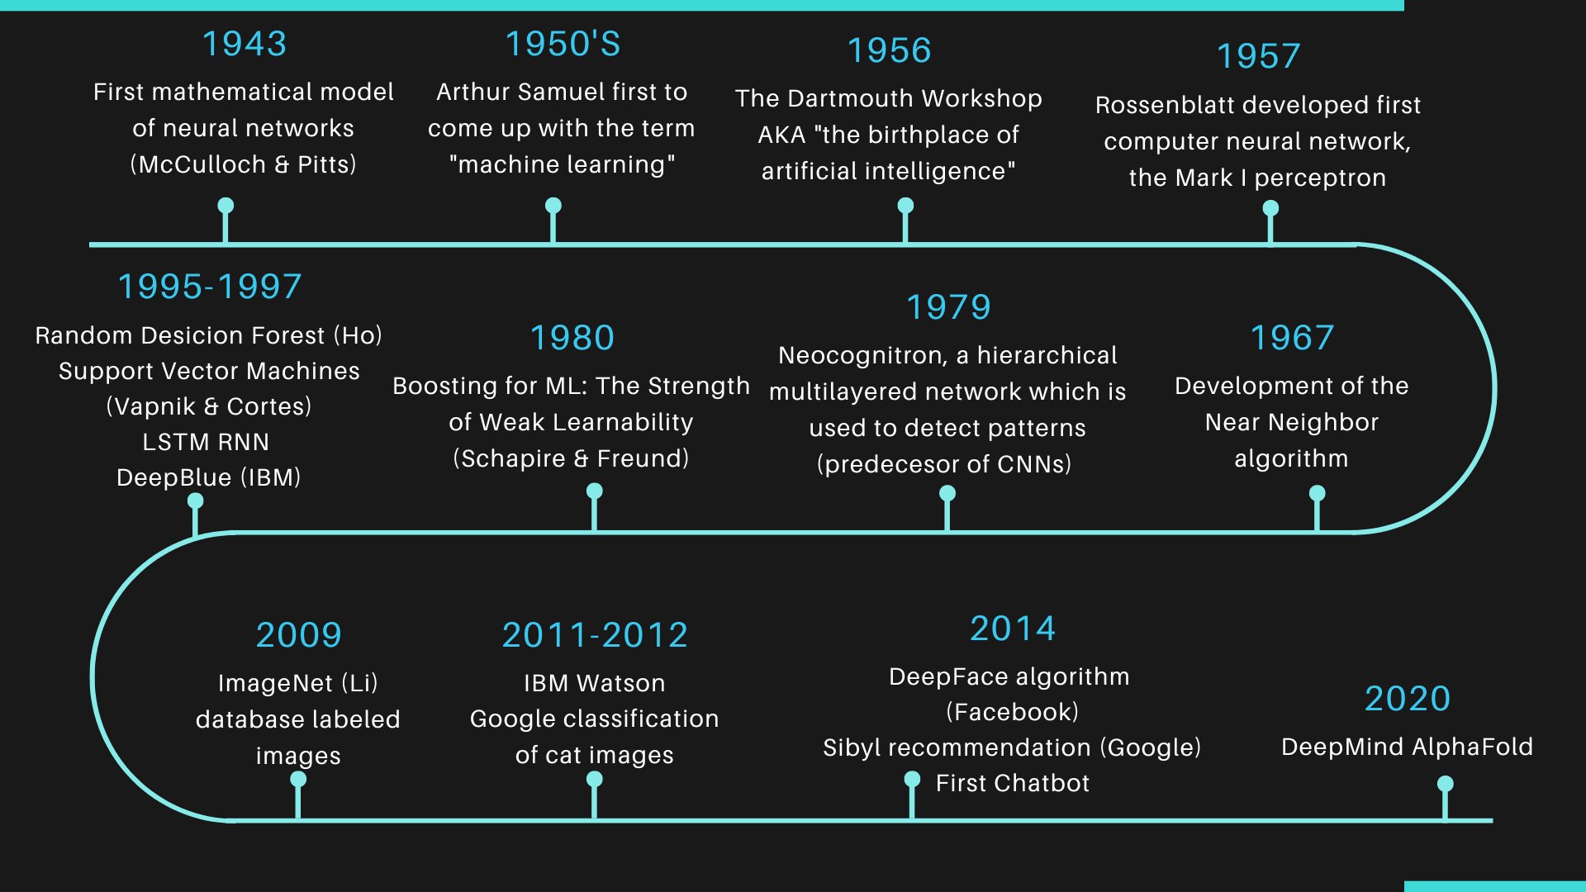
A Snapshot of History of AI/ML

Slide 6
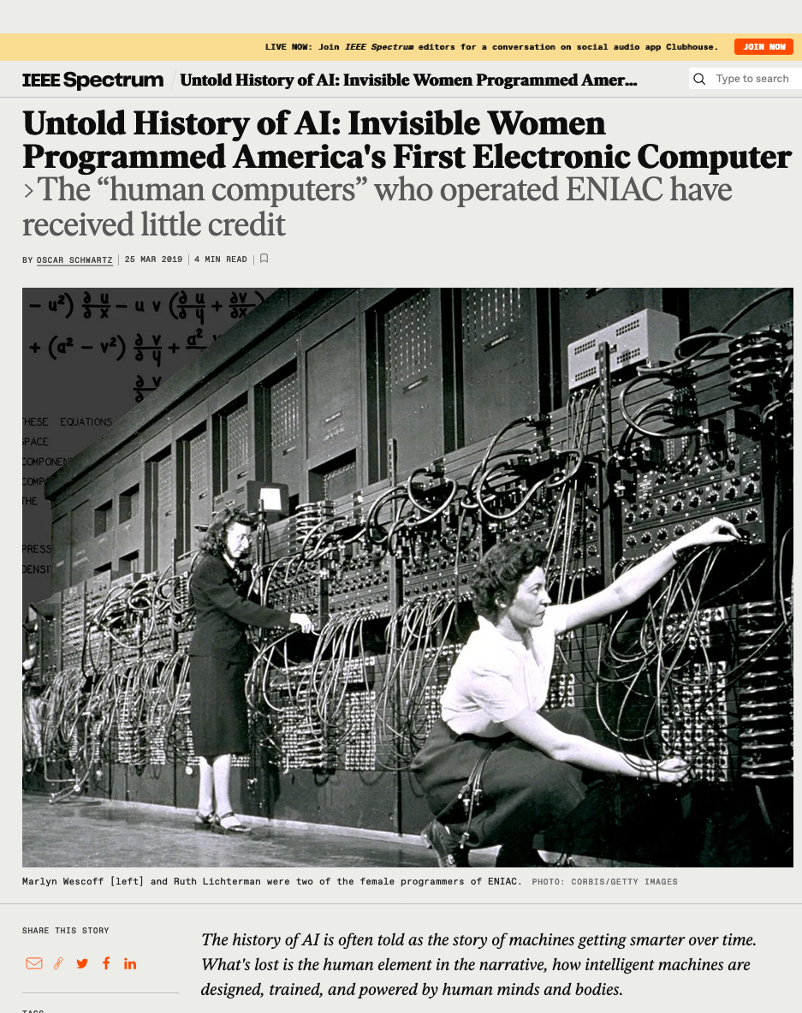
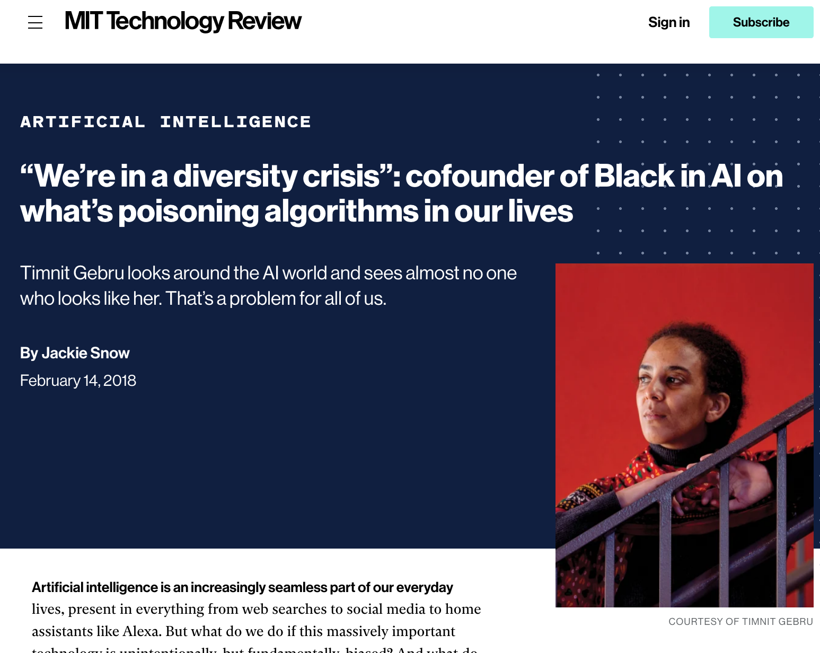
Examining the Timeline Through a DEI Lens
Contributions ignored
No representation
Take a moment to review the different researchers highlighted in this timeline:
https://labelyourdata.com/articles/history-of-machine-learning-how-did-it-all-start
Does anything strike you?
Source:https://www.technologyreview.com/2018/02/14/145462/were-in-a-diversity-crisis-black-in-ais-founder-on-whats-poisoning-the-algorithms-in-our/
Source: https://spectrum.ieee.org/untold-history-of-ai-invisible-woman-programmed-americas-first-electronic-computer

Slide 7
Machine Learning is a Data Driven Approach
Traditional Paradigm
Traditional paradigm
Machine learning

Slide 8
What does learning mean in ML?
“A computer program is said to learn from experience E with respect to some class of tasks
T and performance measure P, if its performance at tasks in T, as measured by P, improves
with experience E.” - Professor Tom Mitchell (1997)
The Task, T
The Experience, E
The Performance, P
Exact problem to solve
Classification or categorization
Regression
Anomaly detection
Translation
Clustering or grouping
Learning algorithm or model learns inherent pattern from data
Supervised learning
Unsupervised learning
Semi-supervised learning
Reinforcement learning
A quantitative measure or metric used to see how well the model is performing the task T with experience E
Accuracy
Precision
Recall
F1 score
Error/Misclassification rate

Slide 9
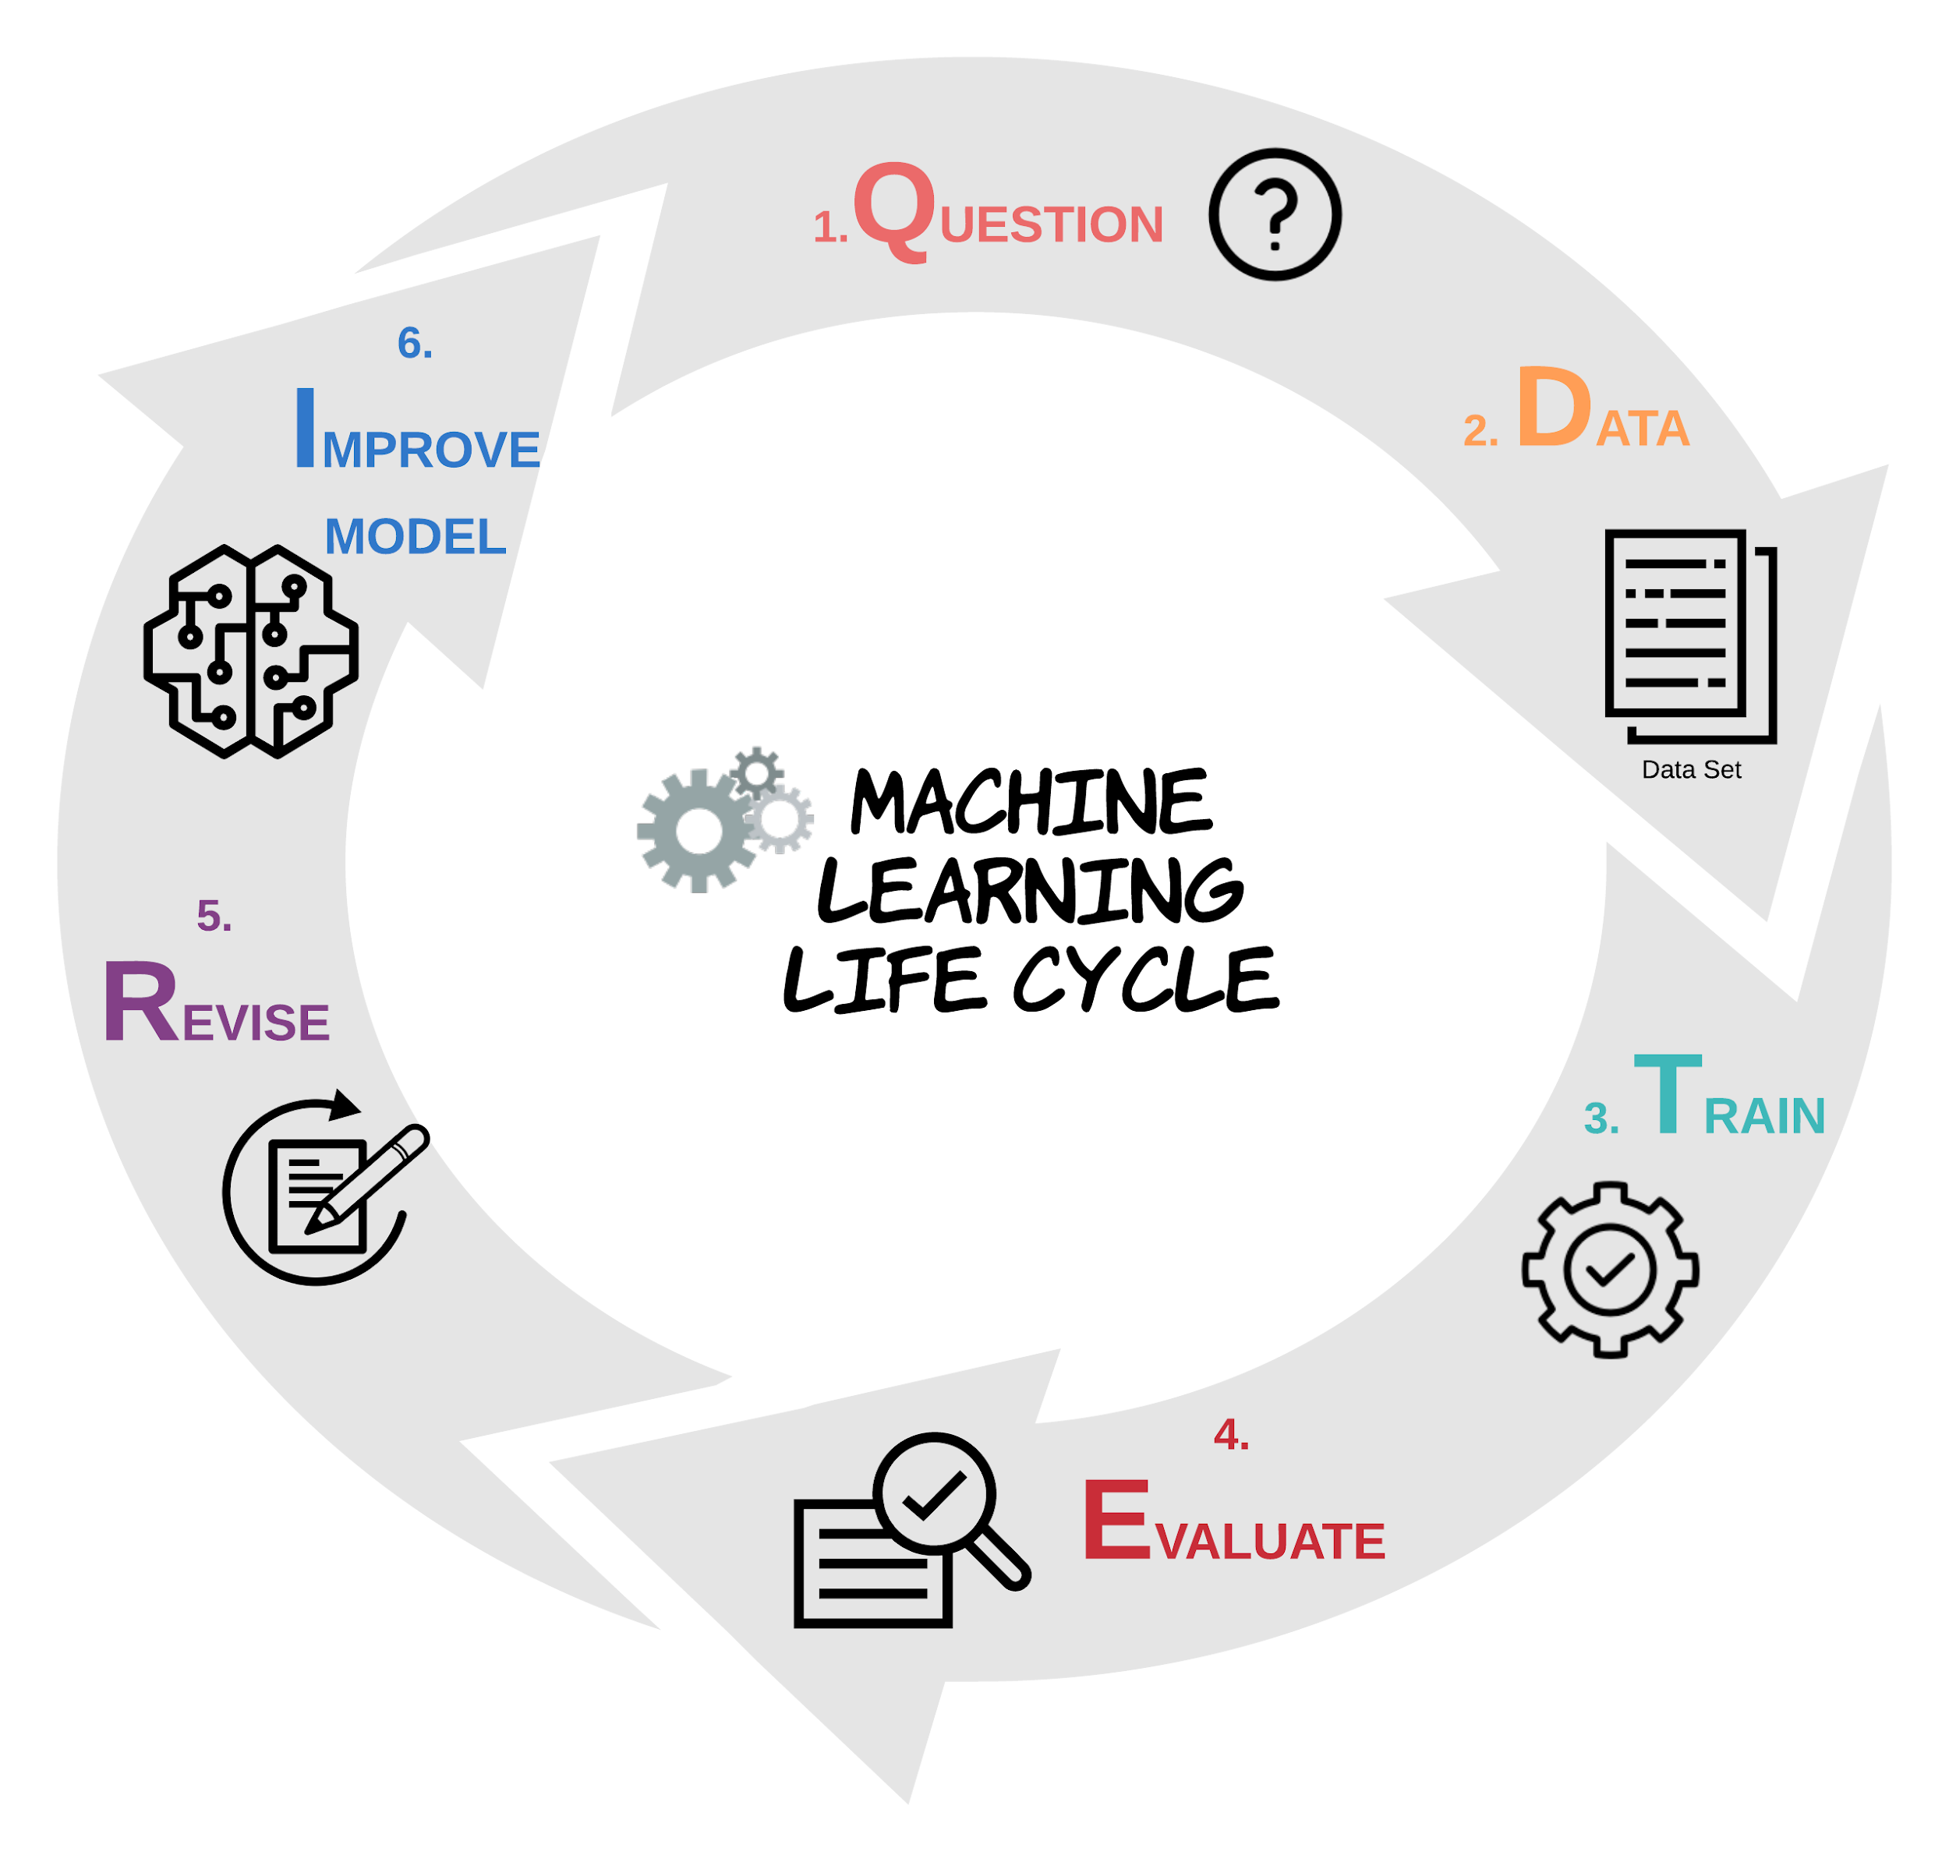
Task
Experience
Performance
Notes:
,

Slide 10
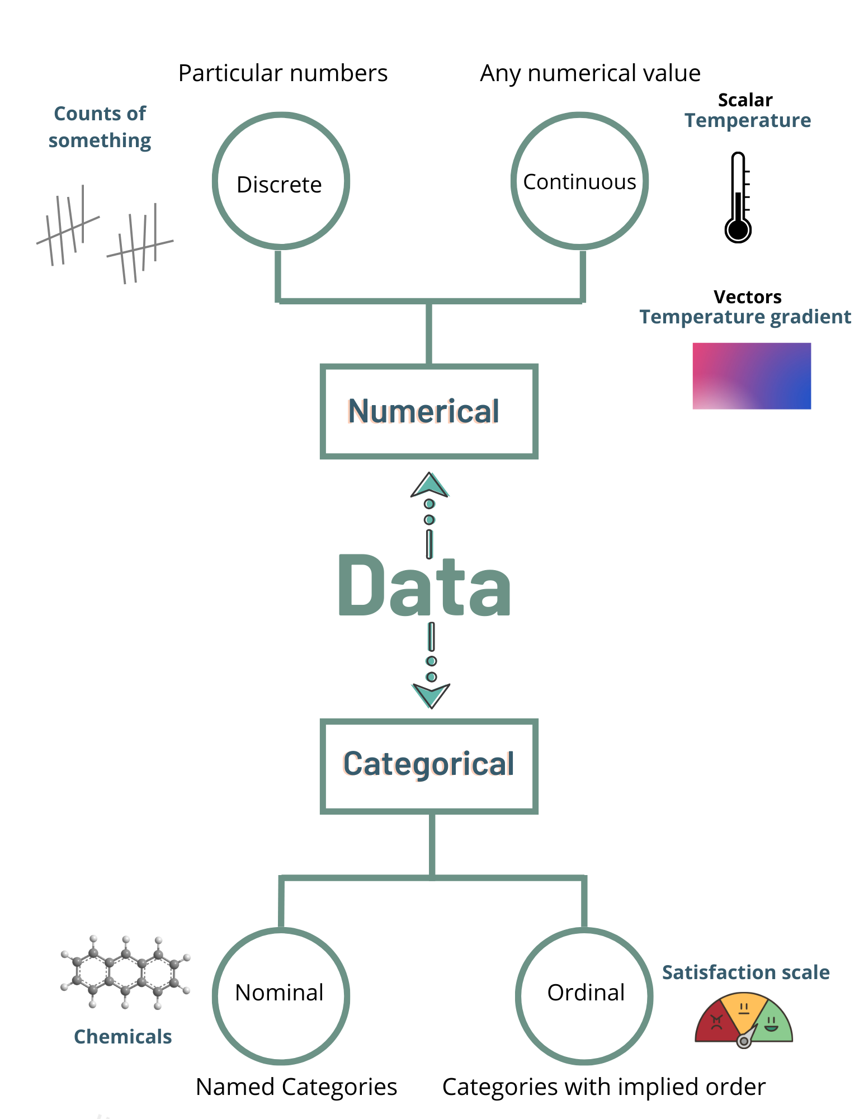
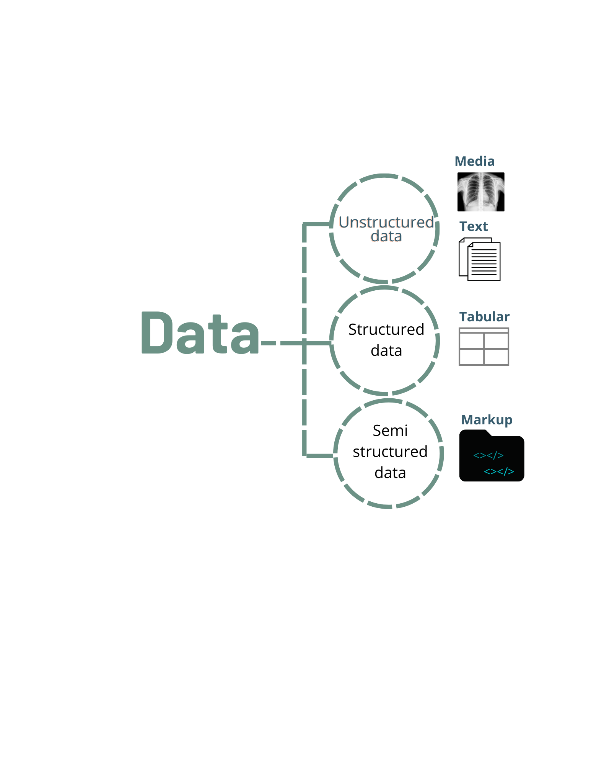
Data Literacy
Algorithms
Important to know data types to correctly apply methods to the data

Slide 11
Algorithms
Now, what data types are the following examples?
Ethnicity
Numerical
Discrete
Continuous
Categorical
Nominal
Ordinal
Place in a competition
Molecular mass
RNAseq read count
Names of bioentities
Distance
Number of CPUs
Course satisfaction scale

Slide 12
Algorithms
What is a ML model?
A model is the output of a machine learning algorithm after training on data, which can make predictions or decisions
Algorithms are the tools whereas models are the results
Characteristics of ML algorithms:
Characteristics of model
Acts on data to create models.
General-purpose and reusable across datasets.
E.g., Linear Regression, Decision Trees, Neural Networks.
Dependent on specific data and task.
Customized to solve particular problems.
E.g., A trained regression equation, a decision tree, a neural network..

Slide 13
Machine Learning Methods
The Experience, E
The amount of human supervision involvement
The ability to learn from incremental data
The approach to generalization from data
Supervised learning
Unsupervised learning
Semi-supervised learning
Reinforcement learning
Batch (offline) learning
Online learning
Instance based learning
Model based learning

Slide 14
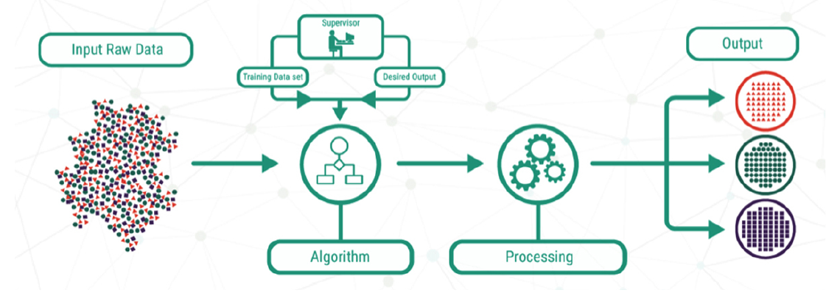
Supervised Learning
E
The amount of human supervision involvement
Source: Lucidchart
To model the relationship between the inputs and their corresponding outputs from the training data, as labeled by humans, to predict output responses for new data inputs

Slide 15
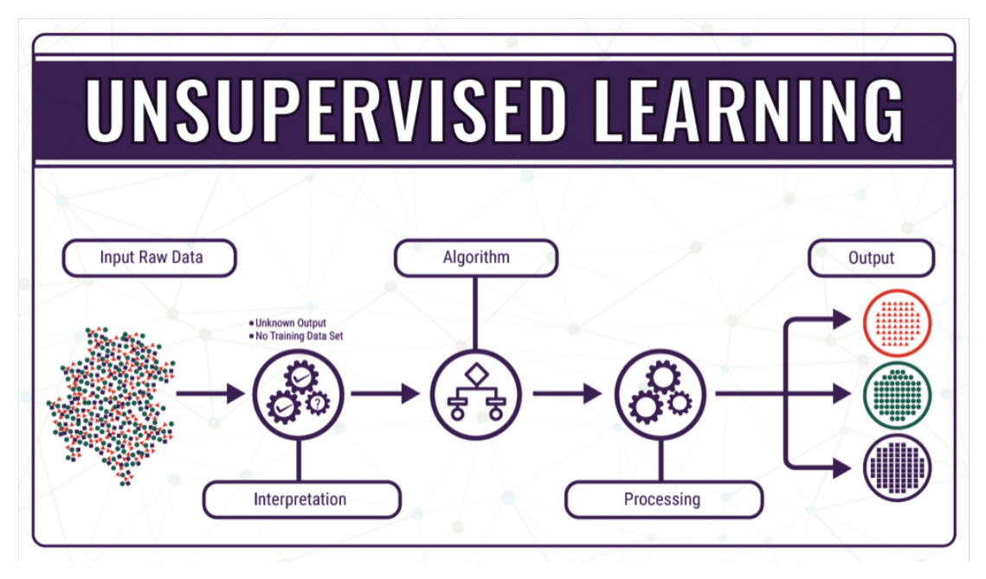
Unsupervised Learning
E
The amount of human supervision involvement
The amount of human supervision involvement
Source: Lucidchart
To learn inherent latent structures, patterns and relationships from given data without any help or supervision (No labeled data)

Slide 16
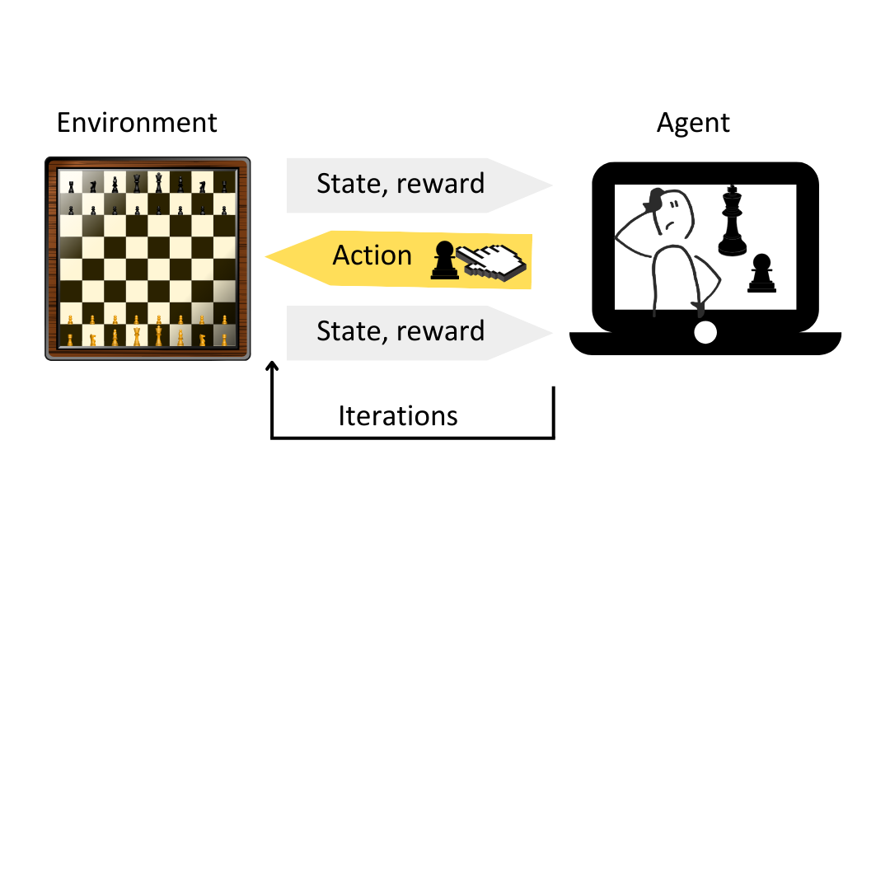

Reinforcement Learning
E
The amount of human supervision involvement
The amount of human supervision involvement
Feedback-based learning method. An agent is trained with reward-penalty over some action, learns automatically with these feedbacks and improves its performance.
Steps:
Prepare agent with set of initial policies and strategy. Observe environment and current state
Select optimal policy and perform action
Get corresponding reward (or penalty)
Update policies if needed
Repeat Steps 1-4 iteratively until agent learns the most optimal policies
1
2
3
…
4
5

Slide 17
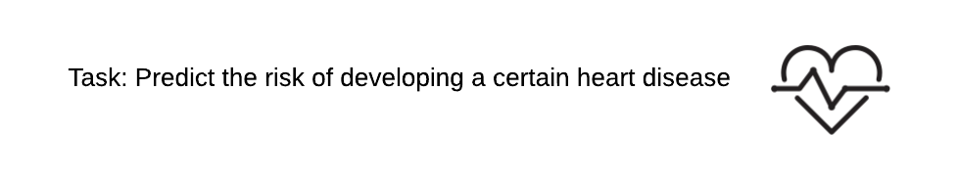
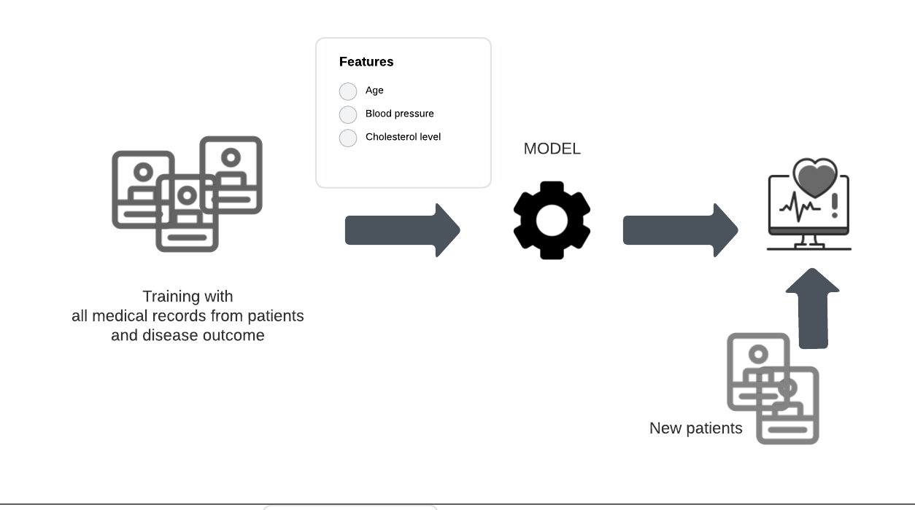
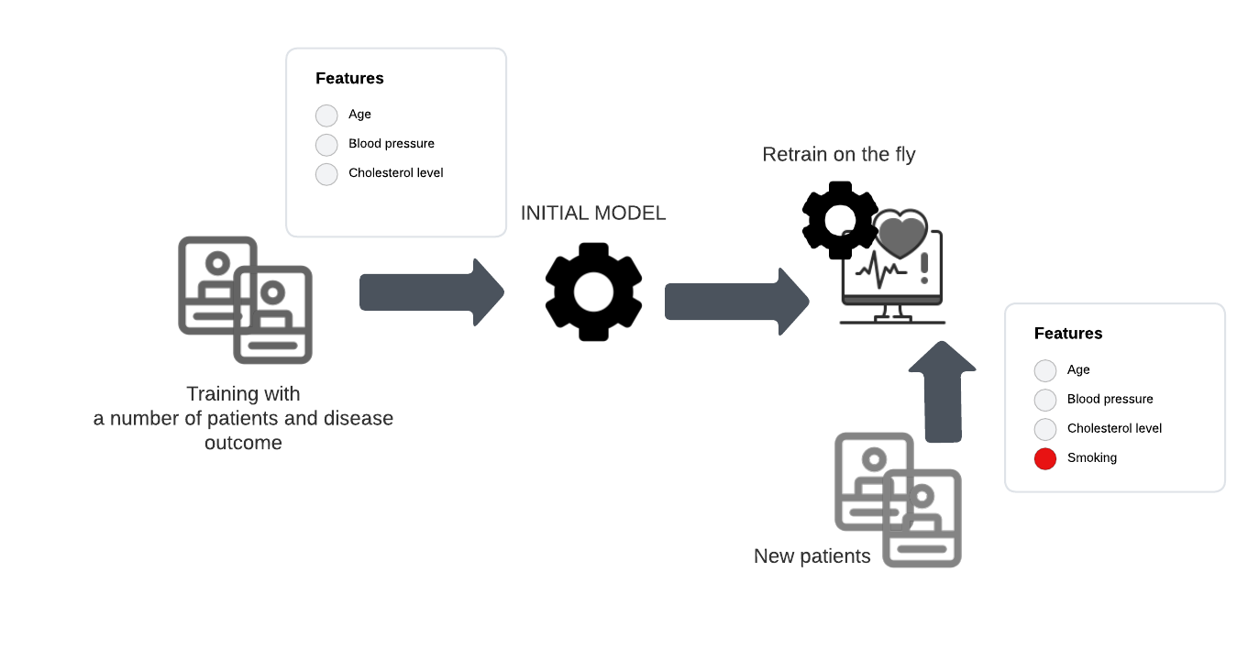
Batch (Offline) vs. Online Learning
E
The ability to learn from incremental data
Task: Predict the risk of developing a certain heart disease
BATCH (Offline)
ONLINE
Model trained on a fixed dataset and then deployed
Recommended if data distribution does not change frequently
Continuously adapting and learning with new data
Recommended if data distribution changes frequently, as is true in many real-life applications

Slide 18
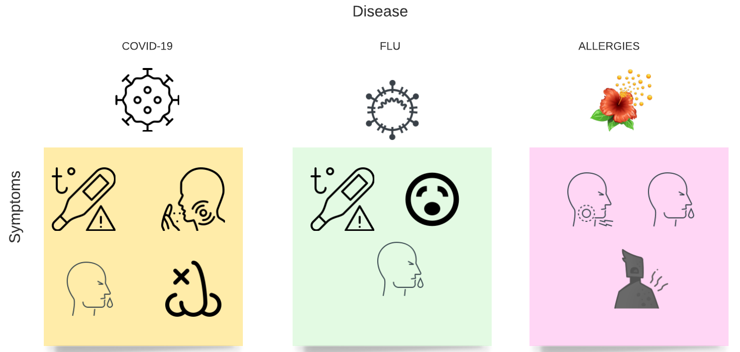


Instance-based learning
E
The approach to generalization from data
BASED ON PREVIOUS OBSERVATIONS/EXAMPLES

Slide 19
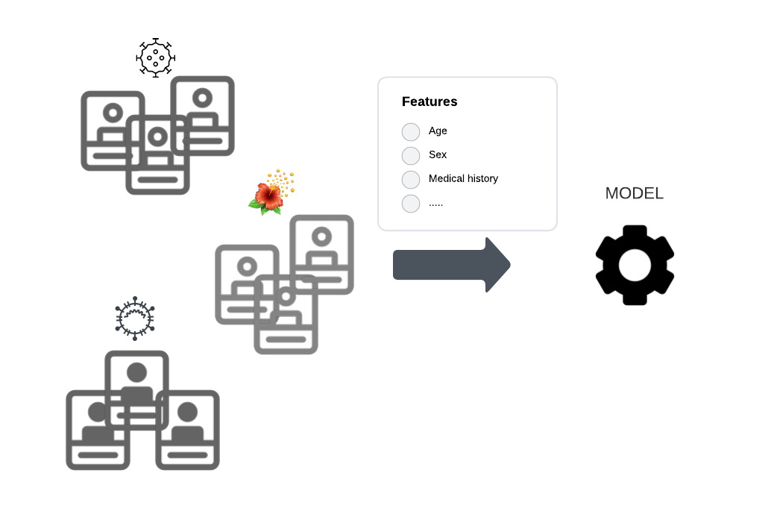

Model-based learning
E
The approach to generalization from data
Prediction
BASED ON PREDICTIONS FROM MODEL

Slide 20
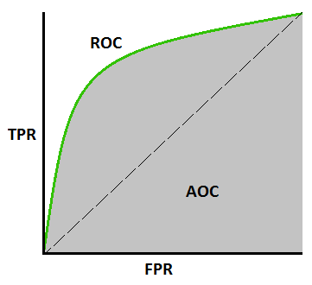
Performance
P
Metrics used, depends on the algorithm selected
Confusion Matrix
Actual
 | Positive | Negative
Positive | TP | FP
Negative | FN | TN
Measure | Formula
Accuracy | TP+TN Total
Error rate | FP+FN Total
Recall (aka true positive rate (TPR), sensitivity) | TP FN+FP
Precision | TP TP+FP
F-1 measure | 2 x Precision x Recall Precision + Recall
False positive rate (FPR) | FP TN+FP
Predicted
1
AUC
0
1

Slide 21

References
Dipanjan Sarkar, Raghav Bali and Tushar Sharma. 2018. Practical Machine Learning with Python. A Problem-Solver's Guide to Building Real-World Intelligent Systems. Apress. (https://doi.org/10.1007/978-1-4842-3207-1), Chapter 1, 2.
Greener, J.G., Kandathil, S.M., Moffat, L. et al. A guide to machine learning for biologists. Nat Rev Mol Cell Biol 23, 40–55 (2022). https://doi.org/10.1038/s41580-021-00407-0
Machine Learning Tutorial. (https://www.javatpoint.com/machine-learning)
Robert Hoyt and Robert Muenchen, Introduction to biomedical data science, Chapter 9.
Timeline: https://labelyourdata.com/articles/history-of-machine-learning-how-did-it-all-start

